Slide 1
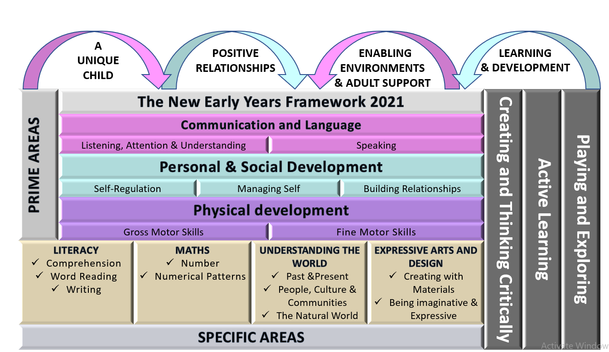
Nursery F1 Long
Term Plan 22-23
At Christ Church Primary School, we aim high and encourage everyone to reach their full potential and to be proud of their achievements.
We feel honoured to be a part of children’s first steps into education and we are committed to their learning, well-being and happiness. We value every child as an individual and are committed to the development of the ’whole child’. We want our children to be confident, happy, independent learners who thrive on challenge and have the self- belief to know that they can do anything they want to do.
Our school is an amazing place to be, staff pride themselves on building strong relationships with both parents/ carers and children. We provide a caring and nurturing environment which enables every child to ‘let their light shine’.
- The EYFS team at Christ Church Primary School

Slide 2
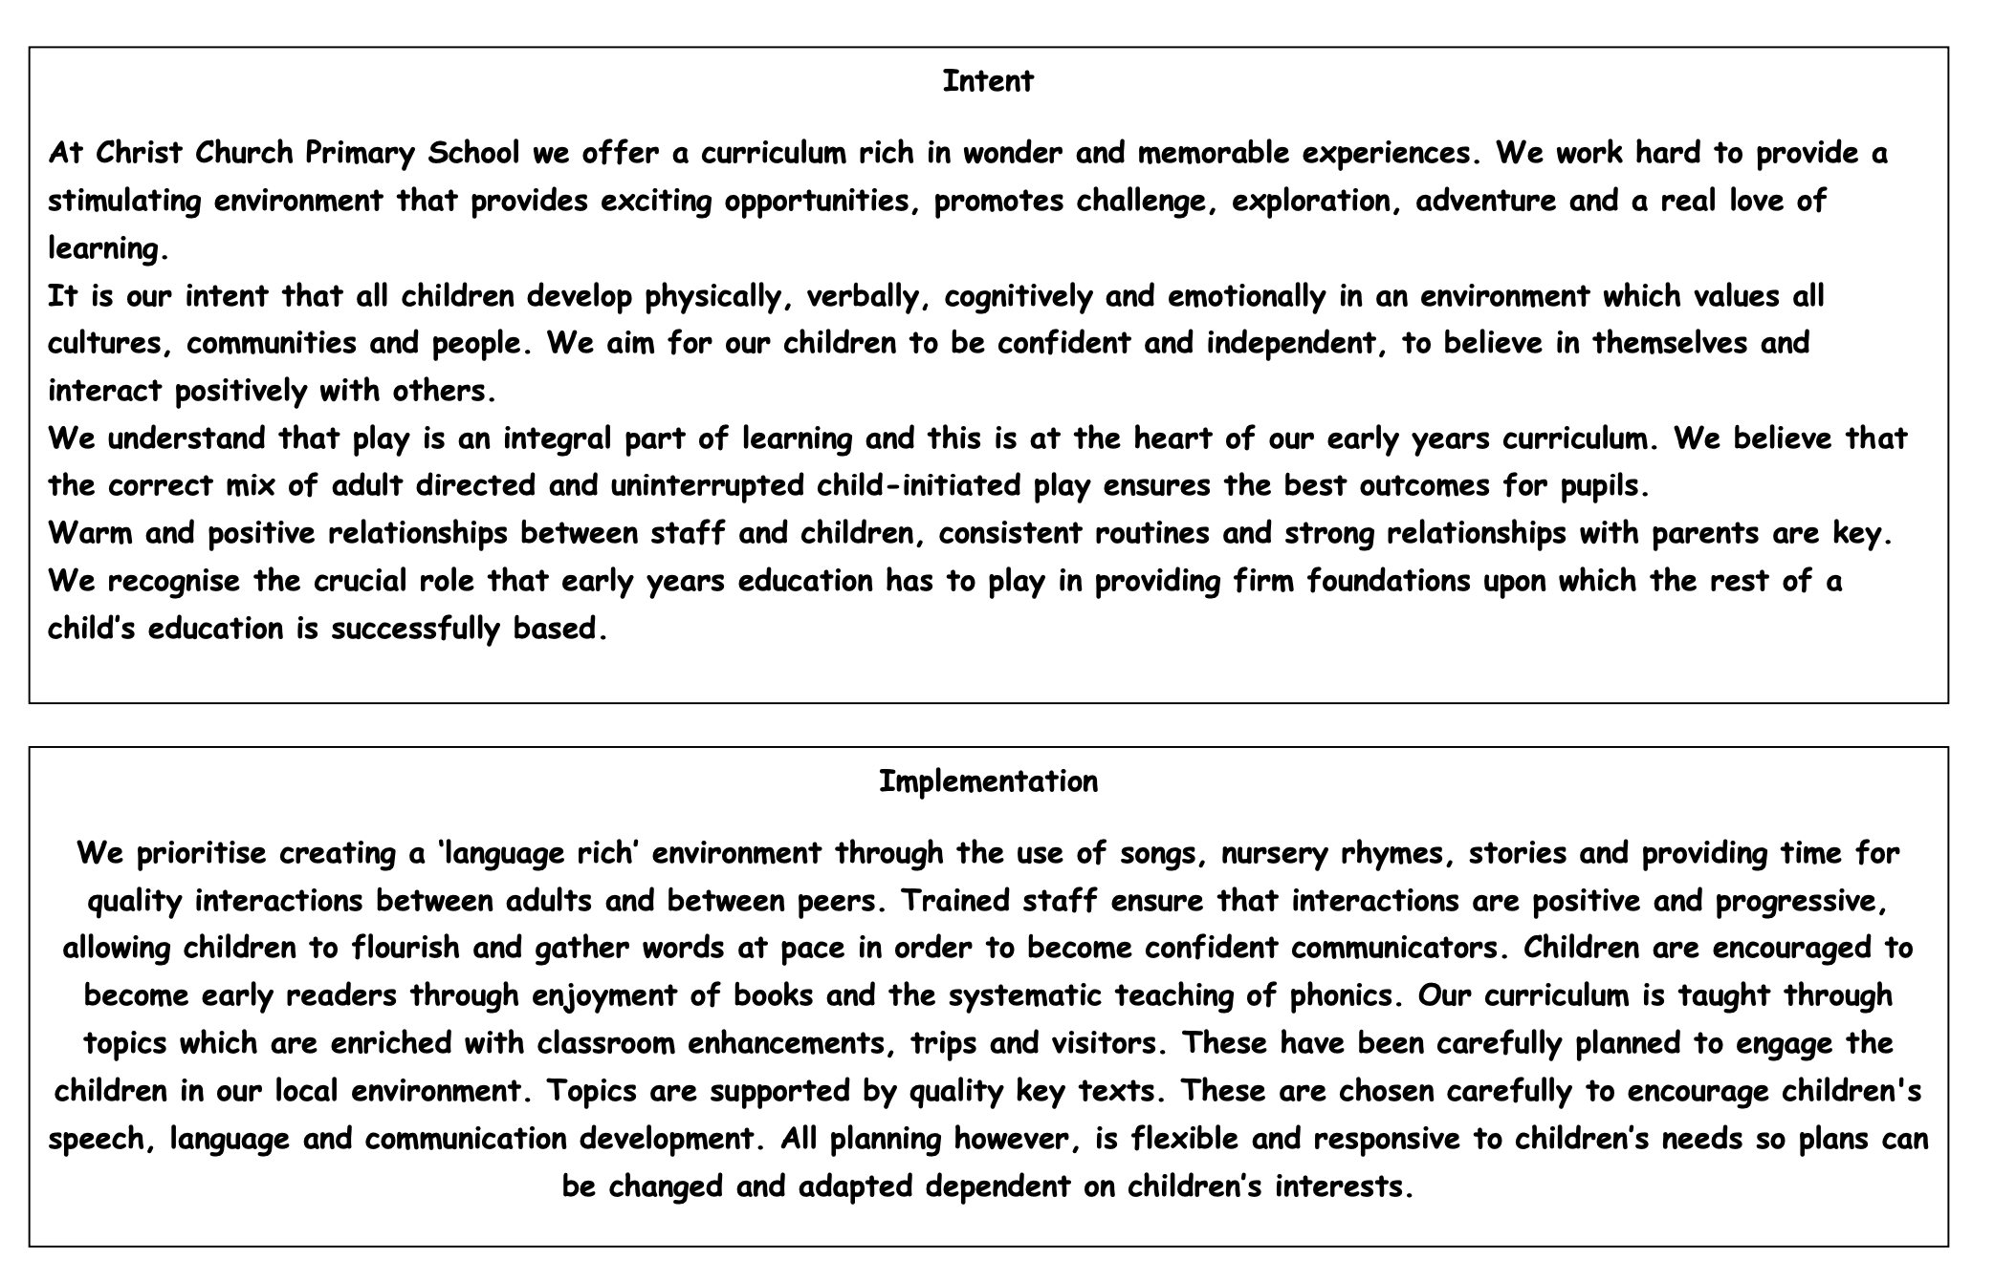

Slide 3
§ | Autumn 1 | Autumn 2 | Spring 1 | Spring 2 | Summer 1 | Summer 2
General Themes NB: These themes may be adapted at various points to allow for children’s interests | All about me! Starting nursery People who help us / Careers My family Autumn and Harvest Diwali Our local community | Nursery Rhymes! Bonfire night celebrations The Nativity Christmas Lists | All Creatures Great and Small Farm animals Pets Chinese New Year | Here, There and Everywhere Maps Fly me to the moon Journeys to school Easter Local landmarks | Come outside! What lives in our pond? Plants and flowers Planting seeds Life cycles of a plant and a chick Minibeasts | Under the sea Where in the world shall we go? Send me a postcard! Seaside in the past Compare: Now and then! Seaside art Reduce, Reuse & Recycle Cameras
High quality Texts | The Kissing Hand Only One You The Big Book of families The Colour Monster Leaf Man The Best Diwali Ever | Incy Wincy Spider Humpty Dumpty Twinkle Twinkle Little Star Miss Polly had a dolly Row, Row, Row your boat The Wheels on the bus Old Macdonald 5 little speckled frogs | What the Ladybird Heard Dear Zoo Dragon Dance | Rosie’s Walk We’re Going on a Bear Hunt Whatever Next | The Enormous Turnip Croc and Bird Rosa’s Big Sunflower | The Singing Mermaid Commotion in the Ocean Tiddler Pirates Love underpants
Supporting texts | So much Lulu’s First Day Brown Bear Brown Bear what do you see? Elmer Feelings We planted a pumpkin We’re Going on a Leaf Hunt | The Very Busy Spider Celebrations around the world Range of stories about festivals The Story of Christmas The Jolly Christmas Postman | Farmer Duck On the Farm Mog and the Vet Peculiar Pets | The Train Ride The Naughty Bus | Jaspers Beanstalk The Tiny Seed Mad about Minibeasts Seed to Sunflower Superworm Non fiction books on chicks and minibeasts Oliver’s Vegetables | What the Ladybird Heard at the Seaside Rainbow Fish Billy’s Bucket

Slide 4
Diversity texts
BAME main characters | Cultural diversity | Neurodiversity | Physical disabilities | Different families
So much Astro Girl Lulu’s first day Baby goes to market Full, full full of love 15 things not to do with a puppy Jabari jumps Izzy gizmo Little people big dreams books | The big book of families Maisie’s scrapbook Hats of faith The jasmine sneeze Golden domes and silver lanterns | We’re all wonders Perfectly norman Incredible you I see things differently Mr Gorski I think I have the wiggle fidgets What makes me a me? The unbudgable curmudgeon | Its ok to be different When Charlie met emma Only one you Don’t call me special Happy to be me Millie gets her super ears | My pirate mums Mt two grandads The girl with two dads We are family Heather has two mummies

Slide 5
Possible themes, interests and lines of enquiry
Autumn 1 | Autumn 2 | Spring 1 | Spring 2 | Summer 1 | Summer 2
Myself Family Feelings People in our community Autumn Harvest Diwali | Halloween Nursery rhymes Bonfire night Christmas | Down on the farm Animals and their babies Pets Chinese new year | Journeys Modes of transport Space Easter Around the world | Life cycles (Egg and sunflower) Planting seeds Minibeasts | Under the sea Sea creatures Pirates Sea conversation

Slide 6
Understanding the world
History | Geography | Science
Past/ present Compare/ contrast Old/ new Family vocabulary e.g. grandparents Time vocabulary e.g. yesterday Before/ after/ a year ago Historical figures- Guy Fawkes, Queen Elizabeth II | Buildings/ Structures Shops, houses, places of interest e.g. library, police station, beach Northumberland Park, North Shields, Church, UK, fish quay, church, town, woods Weather words e.g. rain, wind, snow Seasonal words e.g. autumn winter Seasonal clothes e.g. wellies etc Directional language | Plant, leaves, stem, flower seeds, animal, mini beast names, magnifying class, habitat, attract, repel, metal, wood, fabric, waterproof, float, sink, life cycle, growth, chick, hatch, melt, freeze, human body e.g. body parts
Personal, social and emotional | Physical development | Maths
Behaviour, friend, kind, the best we can be, share, respect, take turns, fair, talk, ask, question, find out, sold problem, feelings, happy, sad, excited, worried, scared, afraid, nervous, brave, try, have a go, reason, talk, speak, interests, opinions, ideas, like, dislike, tooth brushing vocabulary, healthy food vocabulary, hygiene, exercise, resilience | Exercise, heartbeat, sweat, apparatus, bench, mat, climb, balance, crawl, jump, hop, skip, team, muscles, negotiate, space, command, instruction, pattern, chase, obstacles, push, push, throw, catch, bounce, kick, bat, ride, gymnastics, multi-skills, pass, aim, competition Pinch, squeeze, cut, pincer, pour, control, grip | Number zero, number one, two, three etc guess, how many, the same as, too many, too few, not enough, enough, more, larger, bigger, greater, fewer, smaller, less fewest, smallest Pattern, pair, total, forwards, backwards language of shape, size, position, time, capacity, weight, measurement, money

Slide 8
Our Values
Compassion Cat | Fred Friendship | Faye Forgiveness | Kiki Koinonia | Rachel Respect | Tom Trust | Theo Thankfulness
Awareness of feelings Kindness and friendship to other people Celebrate own and others achievements | Value the importance of good friends Recognise that friends can disagree Be a trustworthy and trusting friends Be a friend not a follower | Forgive those who ask for forgives Forgive my own mistakes Forgive mistakes of others Ability to move on from dispute | Work together Encourage and support others Show kindness and compassion Value everyone's unique qualities Unite to create a positive school | Respect for own and others property Respect for the opinion for others Respect for yourself and other people Respect for the beliefs of others | Put your trust in others Trust to always try your best Trust in others to keep you safe Trust we can create great things together | Thankful for our school community Thankful for our talents, gifts and abilities Thankful for the world we live in Thankful for sharing Gods love Thankful for our learning opportunities
Embedded into curriculum and school life

Slide 9
 | Autumn 1 | Autumn 2 | Spring 1 | Spring 2 | Summer 1 | Summer 2
‘Wow’ moments / Enrichment | Occupations Cookery Harvest festival Remembrance Day Visit local shops Diwali | Library Visits Harvest festival Christmas performance Northumberland park Christmas Bonfire night | Shrove Tuesday celebrations Church Dental nurse visit Zoo lab/ Kirkley hall | Science Day Mother’s Day Food tasting – different cultures Space landing and moon picnic Local walk Queen's birthday Science Day World Book Day 3rd March Egg decorating | Whitehouse farm visit Visit to the allotment Bee Day Celebrations Planting Seeds Minibeast hunt | Visit to beach Let’s Fly Green Screen Under the Sea – singing songs and sea shanties Map work - Find the Treasure Father’s Day Pirate Day Sports Day Graduation End of year family picnic New children visits
Assessment opportunities | In-house - Baseline data on entry Phonics assessments Key word assessments Language screener EYFS team meetings Parental info meeting | Baseline analysis Ongoing assessments Pupil progress meetings Parents evenings Team meetings In house moderation | Cluster moderation EYFS team meetings Phase meeting and internal moderations | Pupil progress meetings Parents meetings info Team meetings In house assessment | Team meetings Cluster moderation | Pupil progress meeting Team meeting End of Year Data
Parental Involvement | New starter meetings Seesaw involvement Occupations Book at bedtime Learning at home ideas | Seesaw involvement Nativity Parents Evening Book at bedtime Coffee morning Homework ideas | Seesaw involvement Secret reader Book at bedtime | Seesaw involvement Parents Evening Easter bonnet parade Book at bedtime Stay and play arts and craft | Seesaw involvement Secret reader Stay and play maths | Seesaw involvement Parents Evening End of year Graduation Trip to the beach
Strategies for most vulnerable children | 1:1 Support Support across the curriculum Scaffold learning through play Reading Zones of regulation Speech and Language support Quality First Teaching

Slide 10
Personal, Social and Emotional Development
 | Autumn 1 | Autumn 2 | Spring 1 | Spring 2 | Summer 1 | Summer 2
Managing Self Self regulation Making relationships | SCARF: Me and My Relationships Find ways of managing transition, for example from their parent to their key person. Thrive as they develop self assurance Play with increasing confident on their own and with other children, because they know their key person is nearby Feel strong enough to express a range of emotions Develop friendships with other children Learn to use the toilet with help and then independently | SCARF: Valuing Difference Begin to show effortful control. E.g. waiting for a turn and resisting the strong impulse to grab/push Be increasingly able to talk about and manage their emotions Remember rules without an adult needing to remind them Become more outgoing with unfamiliar people within the setting Notice and ask questions about differences such as skin colour, hair, gender, special needs etc. | SCARF: Keeping myself safe Play with one or more children, extending and elaborating play ideas. Increasingly follow rules, understanding why these are important. Accept simple resolutions suggested by adults and move on with play. | SCARF: Rights and responsibilities Understand gradually how others might be feeling Find simple resolutions to conflicts e.g. accepting that not everyone can be spiderman in the game and suggesting other ideas Be increasingly independent in meeting their own needs e.g. brushing teeth. | SCARF: Growing and changing Talk about feelings using words such as happy, sad, angry or worried. Make healthy choices about food, drink and toothbrushing | SCARF: Being my best Develop their sense of responsibility and membership of a community Articulate rules to other children Develop appropriate ways of being assertive Use a wider range of adjectives to describe their feelings of friends and story characters

Slide 11
Communication and Language
Autumn 1 | Autumn 2 | Spring 1 | Spring 2 | Summer 1 | Summer 2
Can listen to other people with interest. Can be easily distracted. (Small group) Understand simple about ‘who’, ‘what’ and ’where’ but generally not ‘why’ Develop pretend play e.g. driving the car to the shops Start to develop conversation, often jumping from topic to topic Develop communication which can be understood by others Follow instructions at a one/two level level Learn new words modelled by adults and use in communication | Listen to simple stories and understand what is happening, with help from the pictures. Make themselves understood, and can become frustrated when they can’t Start to say how they are feeling, using words as well as actions. Take part in adult led hands on activities in small groups. Extend vocab, know adults name and explain using words I know. Can ask a variety of questions e.g. What? Where? Who | Understand why questions, like why do you think the caterpillar got so fat? Can listen as a medium sized group with visual support Follow instructions at a 3 word level including colour, size or position concepts. Anticipate and join in with key phrases and events from familiar stories | Know many rhymes, be able to talk about familiar books and be able to tell a long story Enjoy longer stories and can remember much of what has happens Use longer words of four or 6 words Use taught vocabulary in play | Be able to express a point of view when they disagree. Using words as well as actions. Pay attention to more than one thing at a time, which can be difficult . Understand a question that has 2 parts such as ‘get your coat and wait and the door’ Follow a 3 word level instruction in.a specific order Use more specific vocab to name people, objects and describe events in more detail. I can retell stories including the main events. | Start a conversation with an adult or friend and continue it for many turns. Use talk to organise their play. Let’s go on the bus.. you sit there Use new vocabulary throughout the day. Can listen one to one or small groups, even if the topic is not following own agenda
The development of children’s spoken language underpins all seven areas of learning and development. Children’s back-and-forth interactions from an early age form the foundations for language and cognitive development.. The number and quality of the conversations they have with adults and peers throughout the day in a language-rich environment is crucial. By commenting on what children are interested in or doing, and echoing back what they say with new vocabulary added, practitioners will build children's language effectively eading frequently to children, and engaging them actively in stories, non-fiction, rhymes and poems, and then providing them with extensive opportunities to use and embed new words in a range of contexts, will give children the opportunity to thrive. Through conversation, story-telling and role play, where children share their ideas with support and modelling from their teacher, and sensitive questioning that invites them to elaborate, children become comfortable using a rich range of vocabulary and language structures.
C&L is developed throughout the year through high quality interactions, daily group discussions, sharing circles, PSHE times, stories, singing, helicopter stories, speech and language interventions.

Slide 12
Physical Development
Autumn 1 | Autumn 2 | Spring 1 | Spring 2 | Summer 1 | Summer 2
Develop manipulation and control Explore different materials and tools Gain control of body through large movements e.g. waving, kicking, rolling, crawling and walking Clap and stomp to music Start eating independently using a knife and fork Drive bikes and trikes by pushing feet Jump two feet to two feet on the spot Jump down off equipment Turn pages of a book | Choose the right resources to carry their own plan e.g. choosing a spade for a large hole Use one handed tool and equipment e.g. making snips in the paper Beginning to show preference for a dominant hand Show an increasing desire to be independent e.g. dress and undress Run and freeze on command. Climb apparatus using alternate feet, using own hands for support. Thread large beads/ cotton reels Make vertical, horizontal and circular marks | Use large movements to wave flags and streamers, paint and make marks Hop on the spot and travel Bowl, roll, chase and collect heavy objects e.g. tyres. Make marks with palmer grip using crayons. | Increasing be able to use and remember sequences of movement which are related to music Start taking part in group activities which they make up or in teams Drive tricycles by pedaling Use pincer movements to pick up small items Use scissors to cut straight lines of paper or paper in halve. Thread beads, screws, nuts, bolts. | Collaborate with others to manage large items such as moving a long plank safely. Go up stairs or climb apparatus using alternate feet. Run at speed negotiating obstacles Travel above floor height by controlling movement Have a dominant hand for manipulative skills. | Be increasingly independent as they get dressed, doing zips. Use a comfortable grip with good control when holding pens and pencils (tripod grip) Ride/ drive including balance bikes at speed avoiding obstacles Use scissors to cut out simple shapes. Use tweezers and tongs effectively Draw circles and copy VHT
Physical activity is vital in children’s all-round development, enabling them to pursue happy, healthy and active lives. By creating games and providing opportunities for play both indoors and outdoors, adults can support children to develop their core strength, stability, balance, spatial awareness, co-ordination and agility. Gross motor skills provide the foundation for developing healthy bodies and social and emotional well-being. Fine motor control and precision helps with hand-eye co-ordination, which is later linked to early literacy. Repeated and varied opportunities to explore and play with small world activities, puzzles, arts and crafts and the practice of using small tools, with feedback and support from adults, allow children to develop proficiency, control and confidence.

Slide 13
Literacy (Comprehension, word reading)
Autumn 1 | Autumn 2 | Spring 1 | Spring 2 | Summer 1 | Summer 2
Join in with songs and rhymes, copying sounds, rhythms, turns and tempo Say some of the words in songs and rhymes Enjoy drawing freely Have favourite books and seek them out, to share with an adult, with another child or look at them alone Scribbles marks with no meaning Distinguish and name sounds in the environment | Sing songs and say rhymes independently e.g. singing songs whilst playing Notice some print, such as the first letter of their name, a bus door, number or a familiar logo Add some marks to their drawings which they meaning e.g. ‘that says mummy’ Scribbles marks become more purposeful lines go up down, round and round Name and recognise instrumental sounds Anticipate favourite sections in books | Make marks on their pictures to stand for their name Begin to draw simple shapes such as lines, circles and represent writing Can copy rhythms containing 1,2,3 beats using body percussion Clap out syllables such as in their name Learn stories have a sequence, beginning, middle,end | Repeat words and phrases from familiar stories Develop play around favourite stories using props Pretend to write works in a left to right progression- waving scribbles or mock writing Distinguish between the text and illustration in books Become aware of words that rhyme in songs and stories | Develop their phonological awareness so that they can spot rhyme, count and clap syllables of a word, recognise words with the same initial sound. Write letters and marks that resemble letter like shapes May copy some letters from their names Name favourite books and give a brief description of the plot or characters | Understand the 5 key concepts of print: Print has meaning Can have different purposes We read English left to right, top to bottom The names of different parts of the book Page sequencing. Write some or all of their name Use some of their print and letter knowledge in early writing which is relevant to them Write some letters correctly Orally blend and segment simple cvc words. Re-enact short exerts from favourite books
It is crucial for children to develop a life-long love of reading. Reading consists of two dimensions: language comprehension and word reading. Language comprehension (necessary for both reading and writing) starts from birth. It only develops when adults talk with children about the world around them and the books (stories and non-fiction) they read with them, and enjoy rhymes, poems and songs together. Skilled word reading, taught later, involves both the speedy working out of the pronunciation of unfamiliar printed words (decoding) and the speedy recognition of familiar printed words. Writing involves transcription (spelling and handwriting) and composition (articulating ideas and structuring them in speech, before writing)

Slide 14
Writing
Autumn 1 | Autumn 2 | Spring 1 | Spring 2 | Summer 1 | Summer 2
I can randomly scribble on the page, sometimes with both hands. I can begin to balance when sitting. Distinguish and name sounds in the environment Enjoy drawing freely | I can control the marks on the page. I can use a range of tools to make marks and show an interest in my own marks and others marks. Add some marks to their drawings, which they give meaning Scribbles marks become more purposeful lines go up, down road and round. | I can make connections between my actions and the marks being made. Make marks on their pictures to stand for their name. | I can distinguish between the different marks I make. I can tell an adult what my marks mean I can draw lines and circles in the air, on the floor or on large sheets of paper, balancing well and using whole arm and body. I can copy shapes, letter and pictures Pretends to write words in a left to right progression- wavy scribbles or mock writing. | I can identify sounds from my own name in other words I can write some or all of my name Write letters that resemble letter like shapes May copy some letters from their name | I can use some of my print and letter knowledge in my early writing. For example: writing a pretend shopping list that starts at the top of the page; write ‘m’ for mummy. I can write some letters accurately

Slide 15
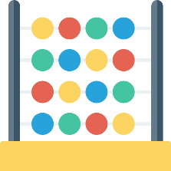
Maths
Autumn 1 | Autumn 2 | Spring 1 | Spring 2 | Summer 1 | Summer 2
Matching, sorting and comparing Match objects which are the same Sort objects into sets based on attributes Compare quantities using language, more, fewer than Can say what is the same and what is different Recite numbers to 5 Talk about pattern around them e.g. stripes on clothes. Use informal language e.g. spotty | Comparing amounts Recognise numerals of personal significance Say one number for each item in order to 3 Know the let number reached when counting a small set of objects (up to 3) Tells you how many in total Show finger numbers up to 3 Compare quantities using language more then, fewer than Begin to understand positional language Experiment with own symbols and marks | I know that the last number reached when counting objects is how many in total Say one number in order to 5. Recognise numerals 1 to 3 Link the numerals to the amounts to 3 I can bring one or two objects to and adult when asked | I can create a simple ABAB pattern Say which is heaviest or lightest. Make comparisons between objects relating to capacity. Use language nearly full, full, empty. I can use number names to ten I can give one more object when asked | I can recite some number names in sequence I can show interest in and join in with number rhymes I can correct a simple pattern I can show understanding of simple comparisons – less I can take one object away when asked I have fast recognition of three objects I can compare quantities | I can say one number name for each item in order to five I can link numerals and amounts I can show finger numbers up to five I can use mathematical language to describe shapes I can identify numerals in the environment I can represent numbers using marks Talk about and explore 2d Shapes
Developing a strong grounding in number is essential so that all children develop the necessary building blocks to excel mathematically. Children should be able to count confidently. By providing frequent and varied opportunities to build and apply this understanding - such as using manipulatives, including small pebbles and tens frames for organising counting - children will develop a secure base of knowledge and vocabulary from which mastery of mathematics is built. In addition, it is important that the curriculum includes rich opportunities for children to develop their spatial reasoning skills across all areas of mathematics including shape, space and measures.

Slide 16
Understanding the World
Autumn 1 | Autumn 2 | Spring 1 | Spring 2 | Summer 1 | Summer 2
Make connections between their families and others Notice differences between people Explore and respond to different natural phenomena in school and on trips Use all their senses in hands on exploration of natural materials Begin to make sense of their own life story and family history Show interest in different occupations Know about family structures and be able to talk about who is in their family Notice and talk about changes that occur as we grow Explore the different jobs our families do and people in our community | Continue developing positive attitudes about the differences between people Explore how things work Explore and talk about the different forces they can feel Operate simple equipment e.g. story phones Describe aspects of cultural celebration in very simple terms using new vocab Raise awareness of celebrations from around the world Use simple adjectives to describe the sensory properties of everyday materials | Explore collections of materials with similar and or different properties. Talk about differences between materials and changes they notice. Use computer to complete a simple task Categorise animals by characteristics. Understand that animals live in different places. | I can talk about environments in stories I can talk about places I have visited (e.g.: the park/ASDA) Know about figures of the past Explore different modes of transport. | Talk about what they see using a wide vocabulary. Plant seeds and care for growing plants. Understand the key features of the life cycle of an animal and plant. Complete simple programmes using the computer in the computer suite. | Begin to understand the need to respect and to care for the natural environment and all living things. Notice differences in clothing from the past. Comment on how beach, wood and north shields are same/ different. Be aware of how to look after our environments
Understanding the world involves guiding children to make sense of their physical world and their community. The frequency and range of children’s personal experiences increases their knowledge and sense of the world around them – from visiting parks, libraries and museums to meeting important members of society such as police officers, nurses and firefighters. In addition, listening to a broad selection of stories, non-fiction, rhymes and poems will foster their understanding of our culturally, socially, technologically and ecologically diverse world. As well as building important knowledge, this extends their familiarity with words that support understanding across domains. Enriching and widening children’s vocabulary will support later reading comprehension.

Slide 17
Expressive Arts and Design
Autumn 1 | Autumn 2 | Spring 1 | Spring 2 | Summer 1 | Summer 2
Explore a range of instruments and play them in different ways Enjoy and take part in actions songs e.g. twinkle twinkle Use props. Similar to the items they represent Use small world props in short non verbal narratives Construct with a purpose Make marks with a range of tools and grips | Express ideas and feelings through mark making and sometimes gives meanings to marks they make Explore different materials, using all their senses to investigate them. Manipulate and play with different materials. Start to develop present play, pretending that one object represents another Know that certain art types belong with certain cultures e.g. rangoli and diva lamps from India. | Explore colour and colour mixing Make simple models which express their ideas. Use their imagination as they consider what they can do with different materials Take part in simple play, using objects to represent something else even though they are not similar. Use mark making tools to make enclosed shapes | Begin to develop complex stories using small world. Explore different materials freely in order to develop their ideas about how to use them and what to make. Sing familiar nursery rhymes Begin to construct, stacking, vertically and horizontally making enclosures and creating spaces | Join different materials and explore different textures Develop their own ideas and then decide which materials to use to express them Create closed shapes with continuous lines and begin to use these shapes to represent objects Use drawings to represent ideas or loud noises. Construct with bricks and blocks to make enclosures Generate simple stories inspired by props Create original stories with small world figures, including dialogues | Make imaginative and complex small worlds with blocks. E.g a city with buildings Show different emotions In drawing and paintings like happiness, fear, sadness Draw with increasing complexity and detail. Such as representing face with circle Remember and sing entire songs. Speak in role in simple storytelling terms
The development of children’s artistic and cultural awareness supports their imagination and creativity. It is important that children have regular opportunities to engage with the arts, enabling them to explore and play with a wide range of media and materials. The quality and variety of what children see, hear and participate in is crucial for developing their understanding, self-expression, vocabulary and ability to communicate through the arts. The frequency, repetition and depth of their experiences are fundamental to their progress in interpreting and appreciating what they hear, respond to and observe.
Give children an insight into new musical worlds. Invite musicians in to play music to children and talk about it. Encourage children to listen attentively to music. Discuss changes and patterns as a piece of music develops

