Slide 2
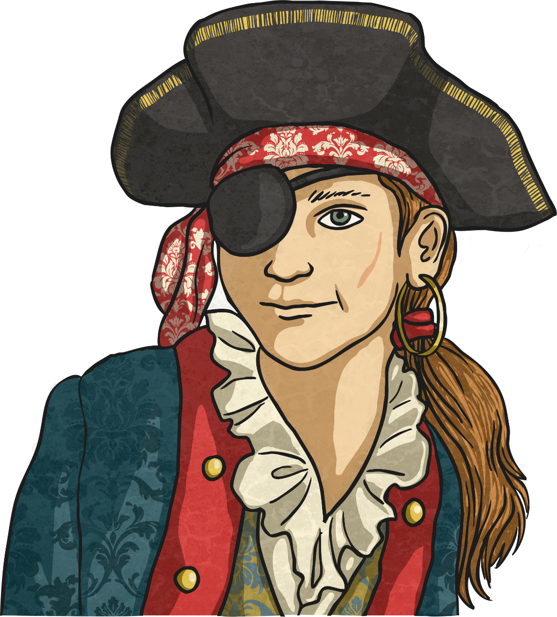
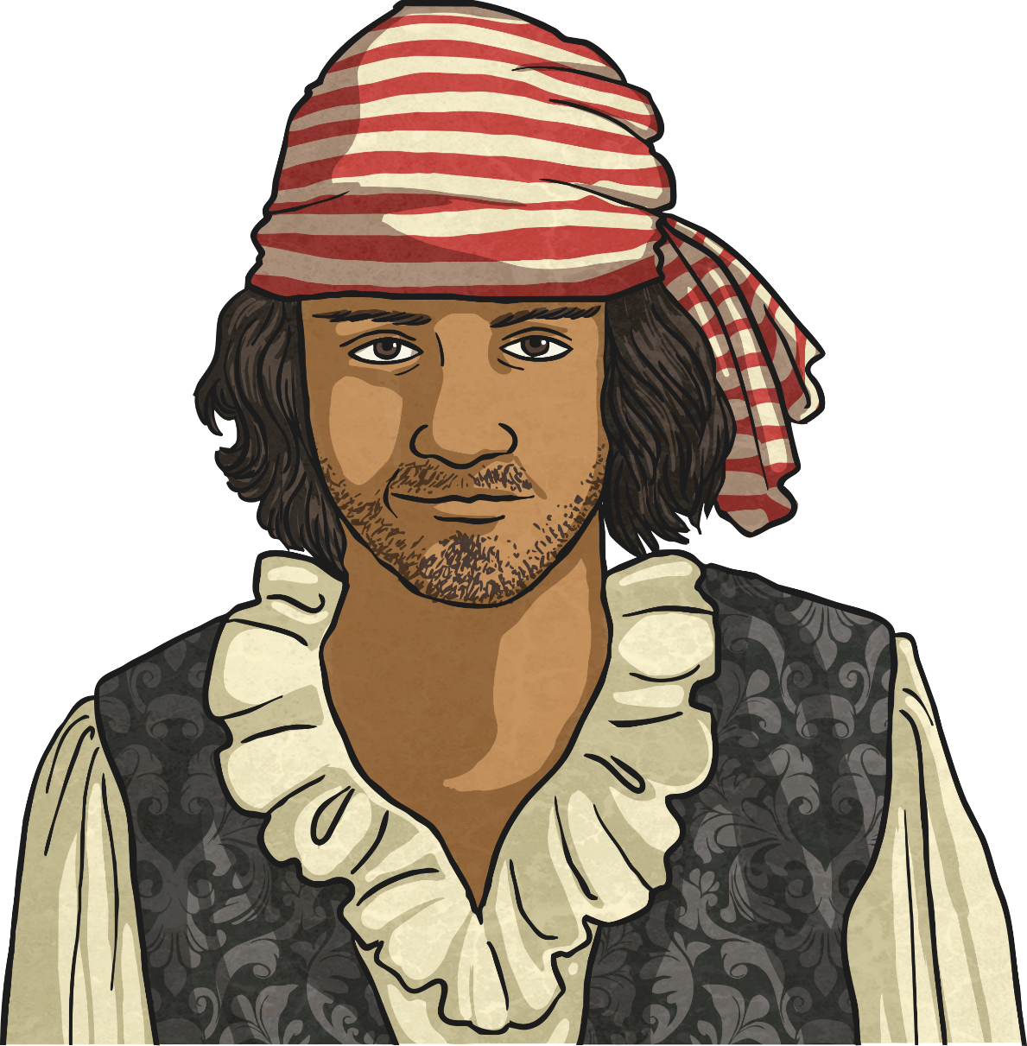
What Is a Pirate?
Pirates are people from any country who steal from ships at sea. (Yes, this still happens now but not quite as often!)
Pirates needed ships of their own (which they stole too) as they worked at sea, stealing loot from other ships.

Slide 3
The Golden Age of Piracy
The period between 1650 and 1730 is commonly known as the Golden Age of Piracy as this was a time when piracy was common. The age can be divided into three main sections:
1716-1726 The Post-Spanish Succession
1650-1680
The Buccaneers
1690
The Pirate Round
Buccaneers were pirates that worked specifically in the Caribbean (where a lot was happening) plundering Spanish ships.
Pirates worked on the specific trade route that covered the Indian Ocean and Red Sea.
After the war of the Spanish Succession, there were many English and American unemployed sailors who turned to piracy and privateering.

Slide 4
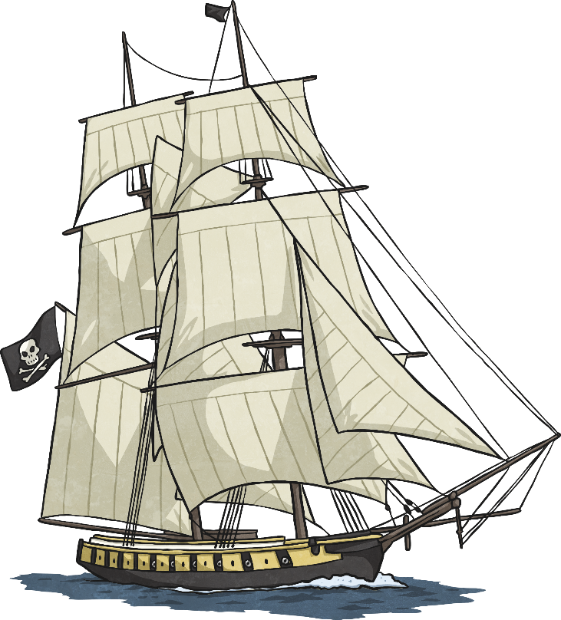
Part of a Pirate Ship
mainmast
yardarm
mizzenmast
rigging
foremast
quarterdeck
jib
deck
ratlines
Spanker boom
bowsprit
stern
helm
bow

Slide 5
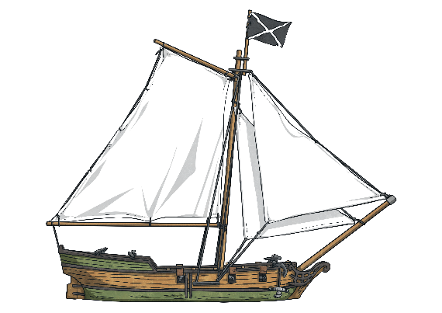
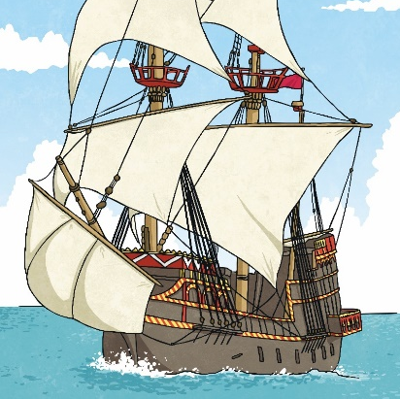
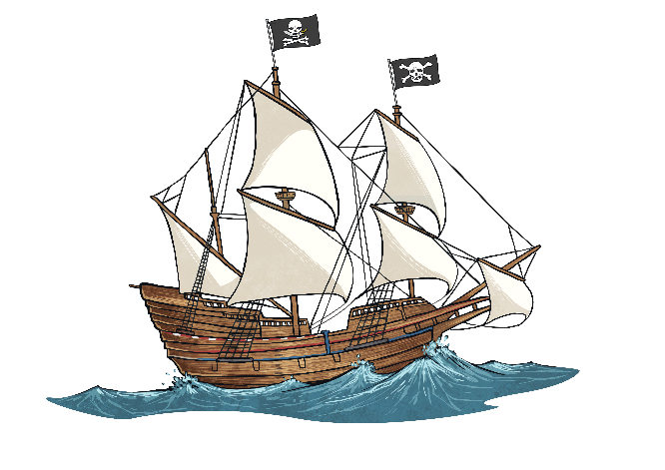
Types of Pirate Ships
Pirates not only stole loot and treasure from other ships, they also stole the ships as well! So pirates used any ships they could get their hands on. However, they did tend to favour the following vessels…
sloop
brigantine
schooner
square-rigger
Let’s Look…
Let’s look at these ships in more detail…

Slide 6
A Sloop
The sloop was one of the quickest ships available and that’s why pirates liked them. Quick enough to out sail the enemy and good in shallow waters.
One Mast
A small boat, which meant it was easier to hide.
It could hold around 75 pirates and 10 cannons.
super-long bowsprit for speed
It was shallow so it could sail in shallow waters.
It had a top speed of 11 knots.

Slide 7
A Schooner
Very similar to the sloop. It was known for its speed and its small size which made it good for hiding.
two masts
Larger than a sloop but it was still small enough to hide.
It could hold around 75 pirates and 10 cannons.
long bowsprit for speed
It was shallow so it could sail in shallow waters.
It had a top speed of 11 knots.

Slide 8
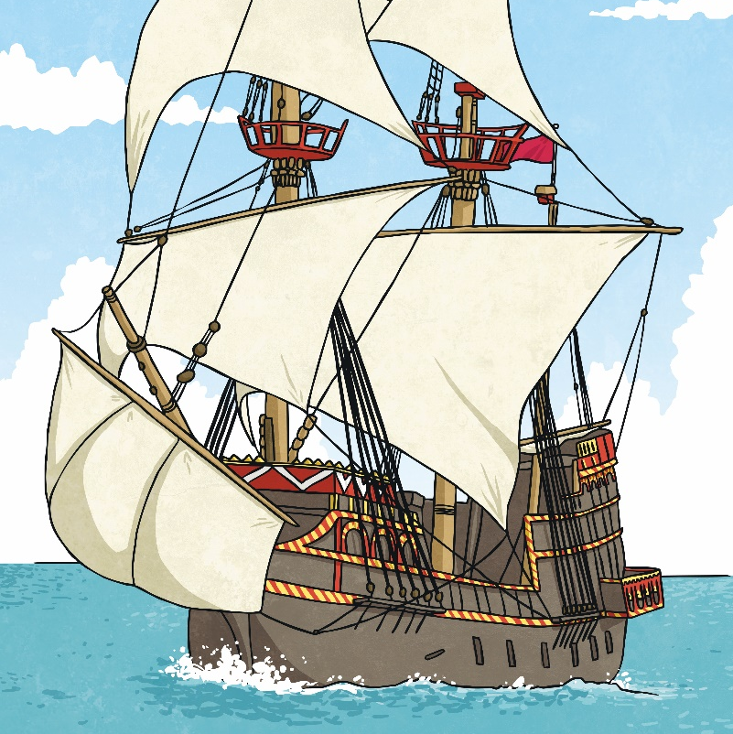
A Brigantine
Larger than the sloop and the schooner, a brigantine had more room and was more powerful.
two masts
excellent steering and handling
It could hold around 125 pirates and 120 cannons.
square-rigged foremast
It had a top speed of over 11 knots.

Slide 9
A Square-Rigger
A pirate ship made for showing off! A square-rigger is so named because of its masts and sails. It includes the ship types of barques, brigs and full-rigged ships.
three masts
A huge ship that would deter enemies.
It could hold around 125 pirates and 120 cannons.
square sails hanging from the yardarms
Extra room for cargo (and loot!)

Slide 10
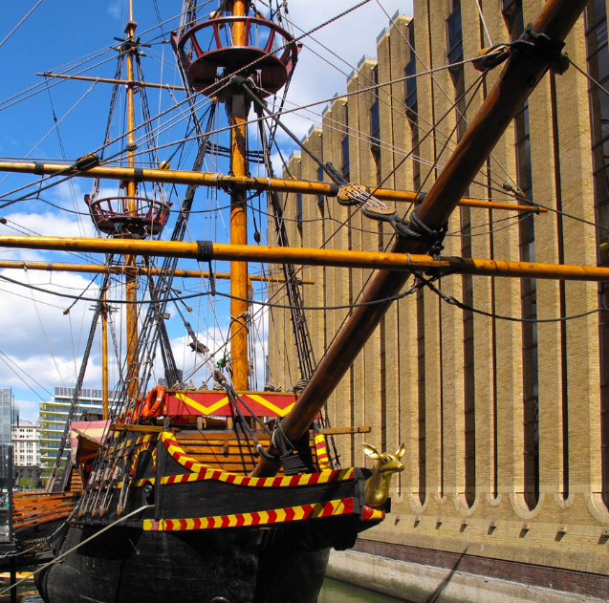
Famous Pirate Ships The Golden Hind
Belonged to: Sir Francis Drake (Privateer for Queen Elizabeth I)
Type: Galleon
Used to be: ‘The Pelican’
Cannons: 18–22
Crew: 80 men
The End: It stayed on display in London until the mid 1600s when it eventually rotted away.

Slide 11
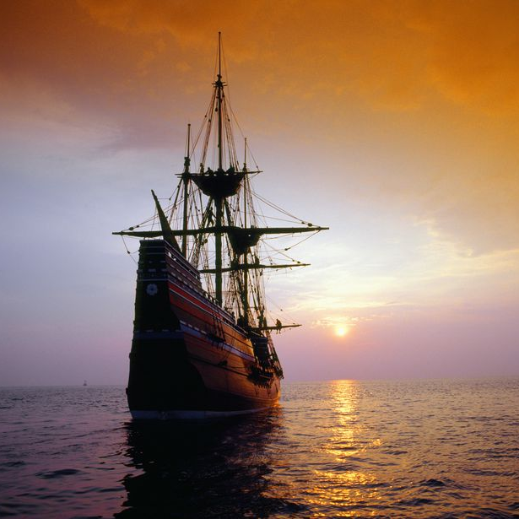
Famous Pirate Ships Queen Anne’s Revenge
Belonged to: Blackbeard (Edward Teach)
Type: Guineaman (a large cargo ship)
Used to be: ‘La Concorde’ – a French ship
Cannons: It had 14 originally but blackbeard added 26 more!
Crew: 280 men
Flag: His flag showed a skeleton piercing a heart with an arrow.
The End: In May 1718, after looting five ships, it was finally run aground.

Slide 12
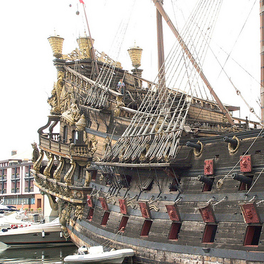
Famous Pirate Ships Royal Fortune
Belonged to: Captain Bartholomew Roberts (also known as Black Bart)
Type: Frigate
Used to be: ‘Onslow’
Cannons: 42
Crew: 157 men
Flag: His first flag depicted him holding an hourglass with death. His second showed him standing on two skulls.
The End:Captain Roberts died in battle on the Royal Fortune in 1722.

